Slide 1
Aspect oriented programming - a.k.a Interception

Slide 2


About me
Антон Попов
Senior Software Engineer in Vivacom
5+ years in .NET (mostly ASP.NET Core)
Lead role in developing team shared infrastructure libraries
Part of multiple workshops and internal events

Slide 3
Agenda
What is AOP and how it differs from OOP
How AOP deals with Cross-Cutting concerns
Decorator Pattern
Implementing simple decorators
Wiring simple decorators with Autofac
Introducing Dynamic Decorators (a.k.a Interceptors)
How to wire Interceptors in Autofac (and Castle DynamicProxy)
Advanced Interceptor configuration
Proxy generation
Proxy generation hooks
Interceptor selectors
Async methods interception*

Slide 4
What is AOP?
AOP is relatively young concept (first described in 1997) in computer science by a guy in Xerox.
Concerned about the use of repetition and boilerplate code in large OOP code basis.
Common examples – logging, caching transacting.
Aspect Oriented programming comes as a result of problems that OOP can’t solve in a clear way.
As a solution to these problems – so called “aspects” are born. They encapsulate cross-cutting concerns an allow them to be reused.

Slide 5
AOP’s purpose – cross-cutting concerns
Cross-cutting concerns – pieces of functionality that are used across multiple parts of a system
Functional requirements – the value adding requirements of your project the business logic, the UI, the persistence (database).
Nonfunctional requirements – secondary, yet essential elements of a project. Examples include logging, security, performance and data transactions.

Slide 6
How AOP works: weaving
Tangling – when the core logic code and the cross-cutting concern code are tangled together. (spaghetti code).
Scattering – the cross-cutting concern code is used in multiple methods and multiple classes (using copy paste, for instance).
Weaving – when you refactor to use AOP (extract to an aspect class) and then tell the AOP tool to apply that logic to the business class.

Slide 7
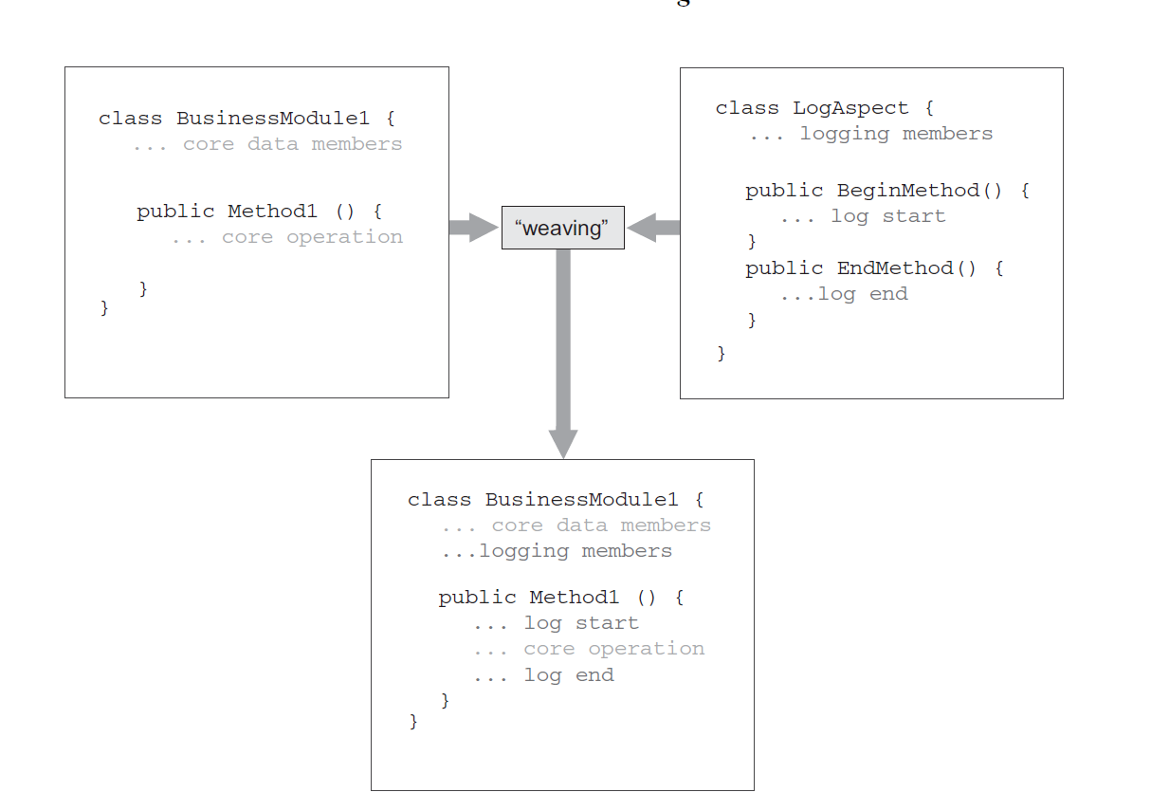
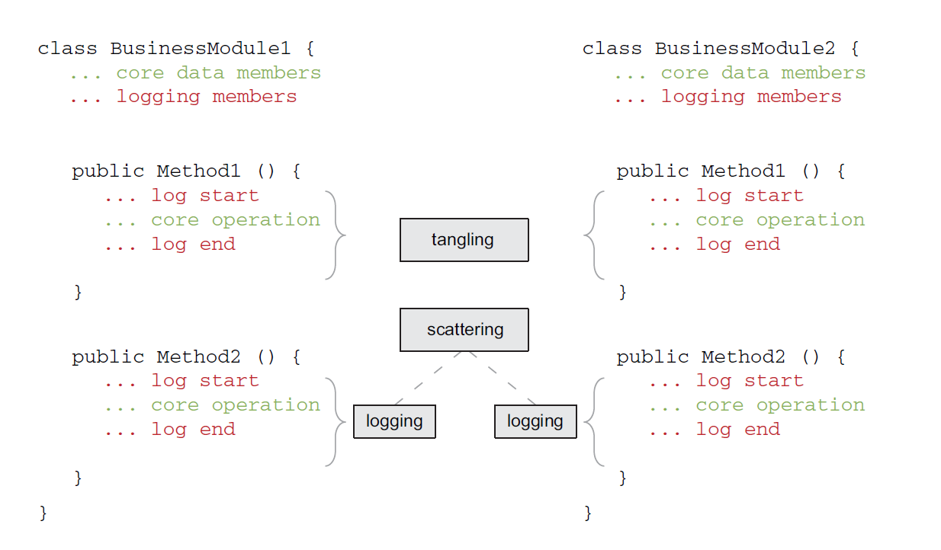
How AOP works:

Slide 8
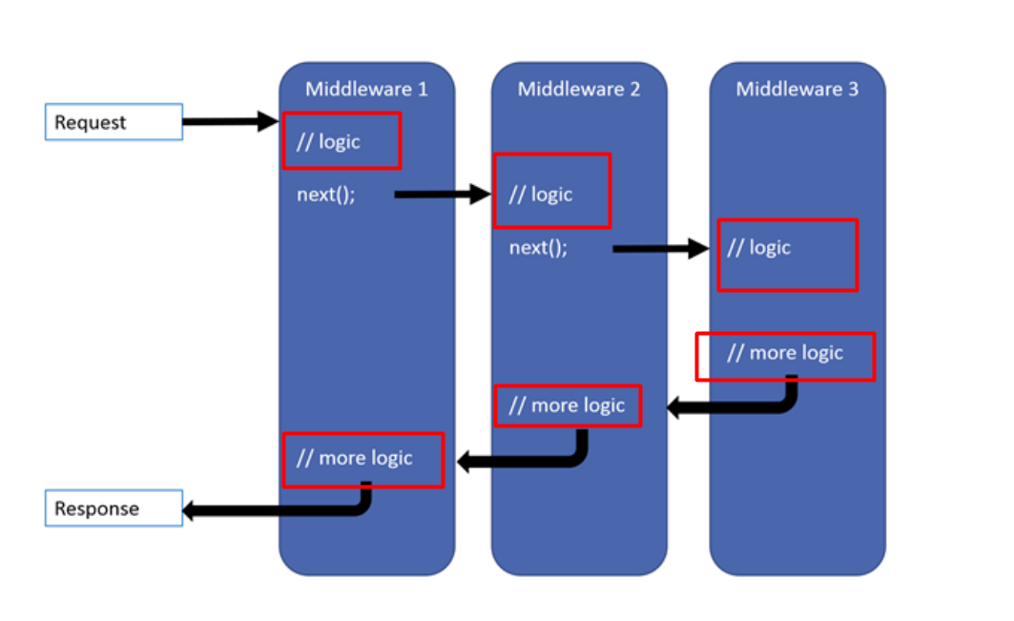
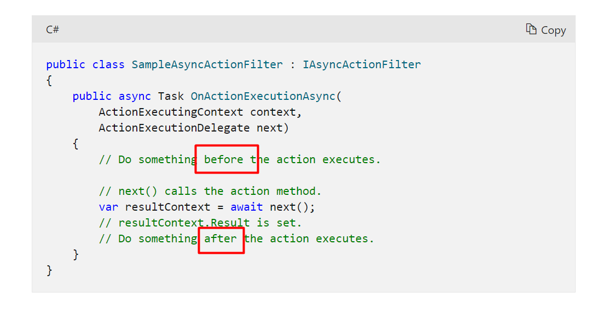
AOP in your daily life:

Slide 9
AOP implementation types
Runtime weaving (Castle DynamicProxy)
Can be easily injected with dependencies at runtime using an IoC container.
Doesn’t require postcompile process, thus it may be easier to adopt.
Castle DynamicProxy is world class AOP framework – free and open source.
Compile time weaving (PostSharp)
If not every object in your project is instantiated by an IoC tool.
If you work in a project which doesn’t use an IoC tool at all.
Gives you the ability to use AOP with any code.
If performance is your primary concern both types of tools will slow down your application in one way or another, though any performance hit caused by AOP is insignificant compared to the gains.

Slide 10
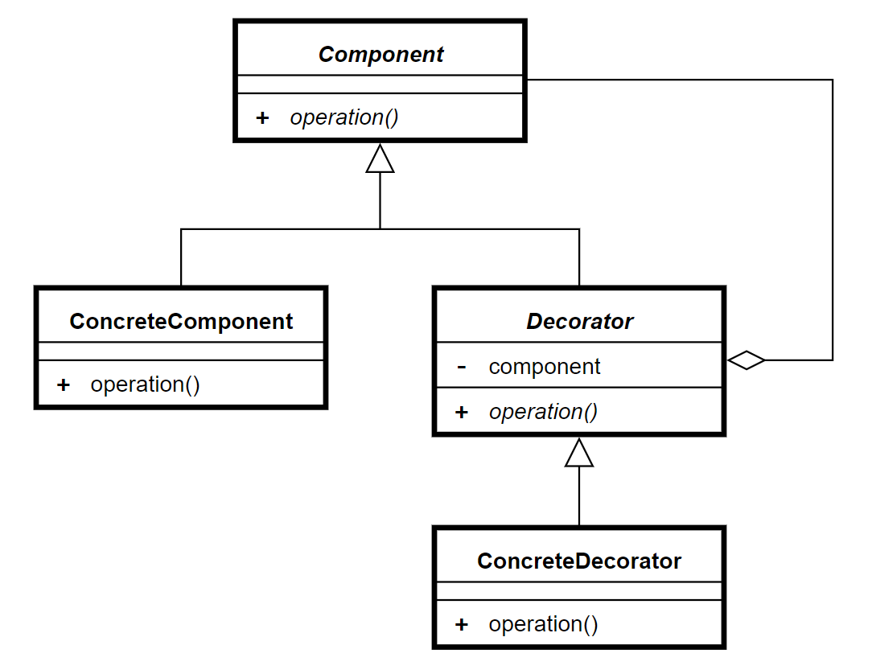
Decorator pattern
Wikipedia: In object-oriented programming, the decorator pattern is a design pattern that allows behavior to be added to an individual object, dynamically, without affecting the behavior of other objects from the same class

Slide 11
Demos
(finally)

Slide 12
Benefits:
The main benefit to using AOP is clean code that’s easier to read, less prone to bugs, and easier to maintain.
Allows new team members to get comfortable and up to speed quickly.
AOP helps you make your code less expensive to maintain.
Refactoring CCC code into its own encapsulated aspect makes it quicker to change all the code in one place.
AOP cleans up spaghetti code.
You will thank your future self!

Slide 13
Summary
AOP isn’t as complicated as it might sound!
All it takes is adjusting the way you think about cross-cutting concerns.
Helps you adhere to the single responsibility principle and use the open/closed principle effectively, without repetition.
AOP allows you to spend more time adding value and less time doing mindless, tedious work.
AOP is an inspiring, powerful tool that’s fun to use ☺

Slide 14
Thank you!
Контакти:
LinkedIn
GitHub
Следващо събитие:
DEV.BG All in One 2021

